Slide 1
CRIMINAL DATABASE
TEAM -17
RAVI TEJA SOMA -85
G ANAND SANJAY REDDY -31
SHASHANK REDDY YATA -92
VIKAS KODURI -43

Slide 2
INTRODUCTION
Criminal database, this application is used to upload the criminal record and retrieve the data back.
This application has two modules police module and the public module.
In the police module, police can upload the crime report of any criminal case.
In the public module, people can notify the police if they found any criminal in the real time and they can report to the police if they need any emergency.

Slide 3
TECHNOLOGIES
ANDROID STUDIO
JAVA
RUBY
JAVA SCRIPT

Slide 4
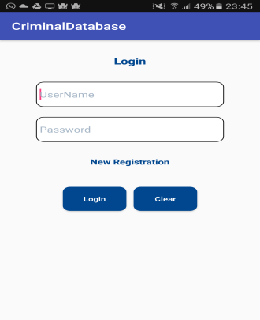
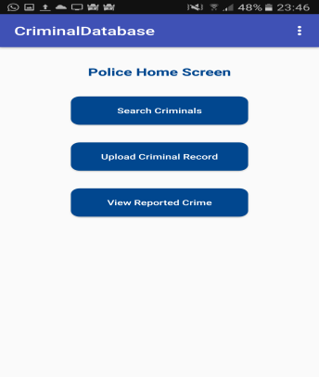
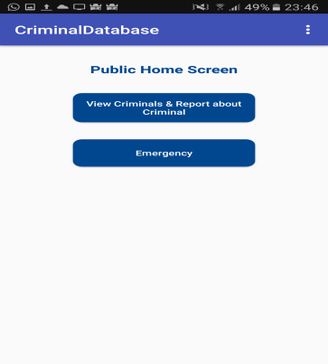
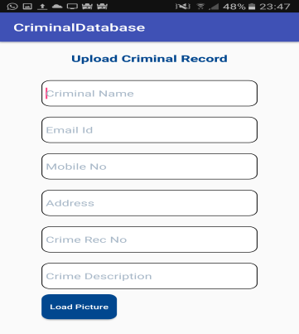
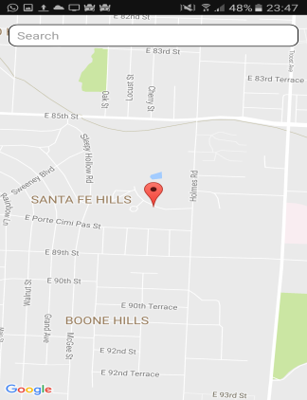

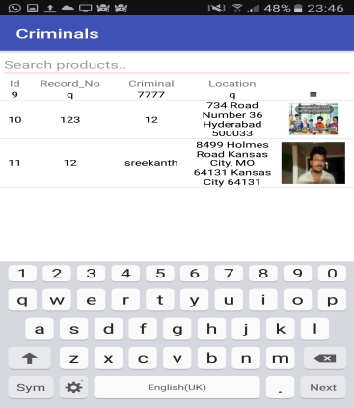
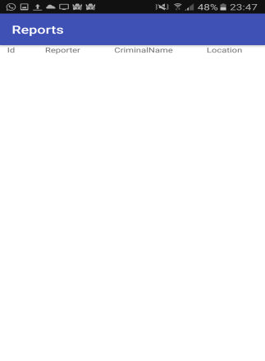
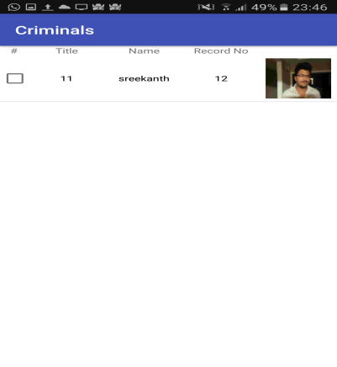
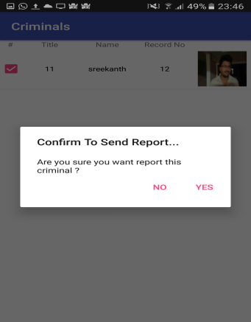
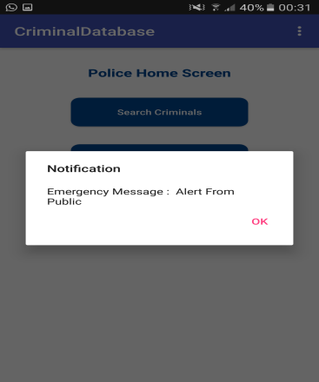
FEATURES OF THE APPLICATION

Slide 5
YOUTUBE LINK
https://www.youtube.com/watch?v=0ILdzO0PVkI

Slide 6
THANK YOU

